Slide 1

Adam Smith on Markets, Competition and Violations of Natural Liberty
Votrag im Rahmen der Ringvorlesung Plurale Ökomomik, Universität Hamburg, 6. November 2014
Heinz D. Kurz
University of Graz and Graz Schumpeter Centre
heinz.kurz@uni-graz.at

Slide 2
Contents
Introduction
Man’s natural faculties, the propensity to exchange, and markets
Market prices and natural prices
The problem of gravitation
Improvements
Asymmetric information, moral hazard and adverse selection
The “wretched spirit of monopoly”
Concluding remark

Slide 3
Literature
Kurz, H. D. and Salvadori, N. (1997). Theory of Production. A Long-Period Analysis, Cambridge: Cambridge University Press, paperback edn.
Kurz, H.D. (ed.) (2008/09). Klassiker des ökonomischen Denkens, 2 vols, Munich: C.H.Beck.
Kurz, H.D. (2010). Technical change, capital accumulation and income distribution in Classical economics: Adam Smith, David Ricardo and Karl Marx, European Journal of the History of Economic Thought 11: 1183-1222.
Kurz, H. D. (2013). Geschichte des ökonomischen Denkens, Munich: C.H.Beck.
Kurz, H. D. and Sturn, R. (2013a). Die größten Ökonomen: Adam Smith, Konstanz and Munich: UVK.
Kurz, H. D. and Sturn, R. (2013b). Adam Smith für jedermann. Pionier der modernen Ökonomie, Frankfurt am Main: Frankfurter Allgemeine Buch.

Slide 4
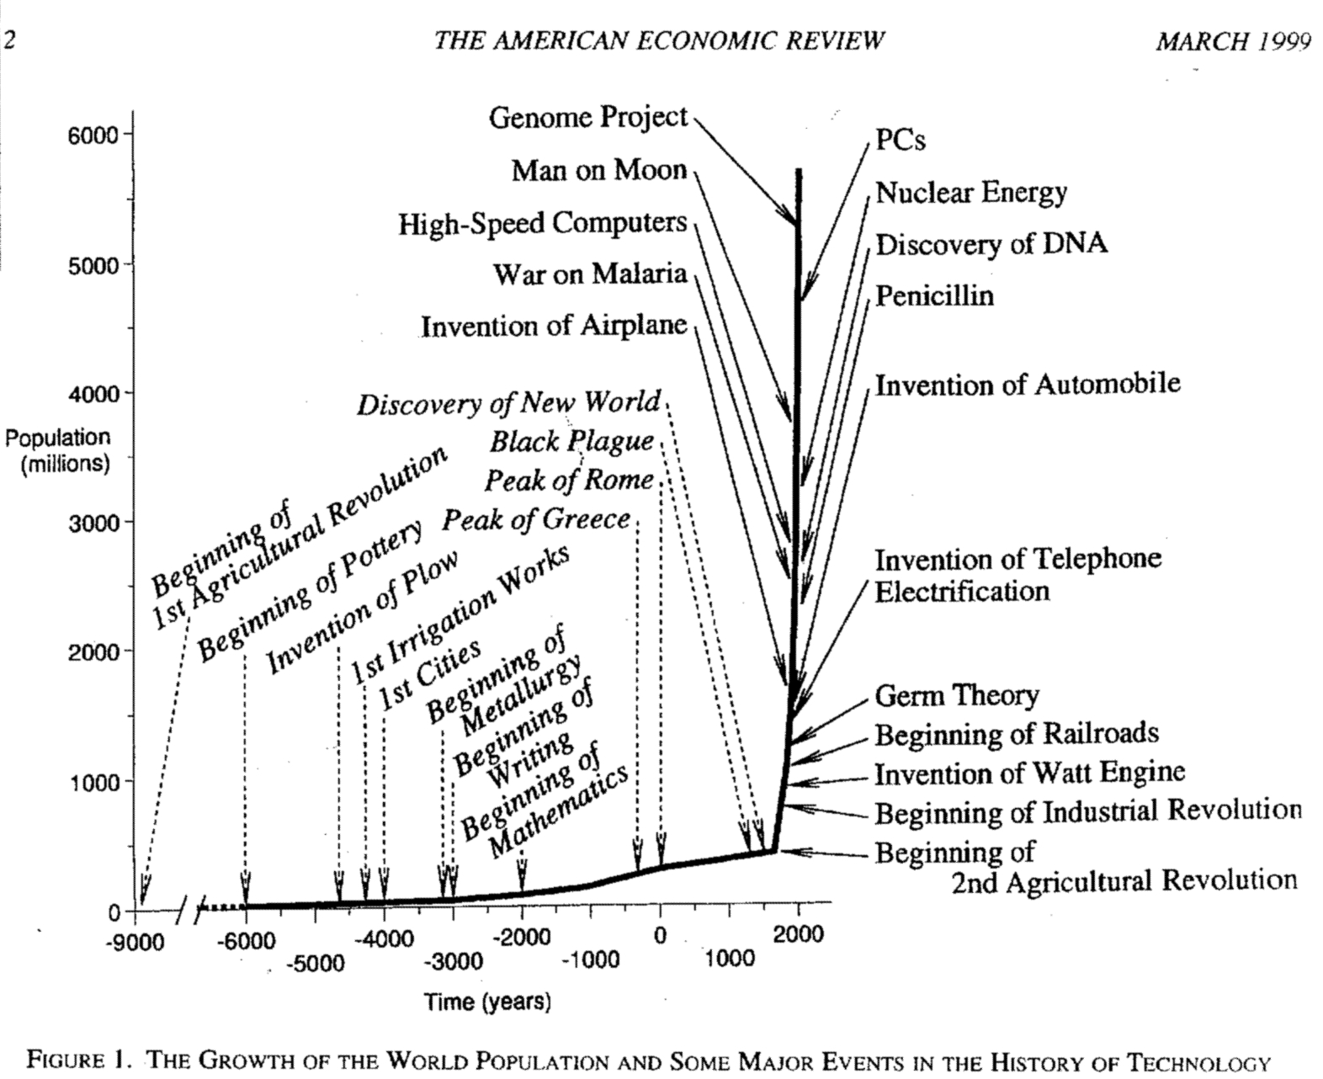

Slide 5

1. Introduction
Adam Smith is said to have advocated the view: “Nothing but selfishness is necessary to yield socially beneficial outcomes.” (Schotter 1985: 2)
Bernard Mandeville, Fable of the Bees or Private Vices, Publick Benefits (1723):
“The Worst of all the multitude Did something for the common good.”
“T’enjoy the World’s Conveniences, Befamed in War, yet live in Ease Without great Vices is a vain Eutopia seated in the Brain”

Slide 6
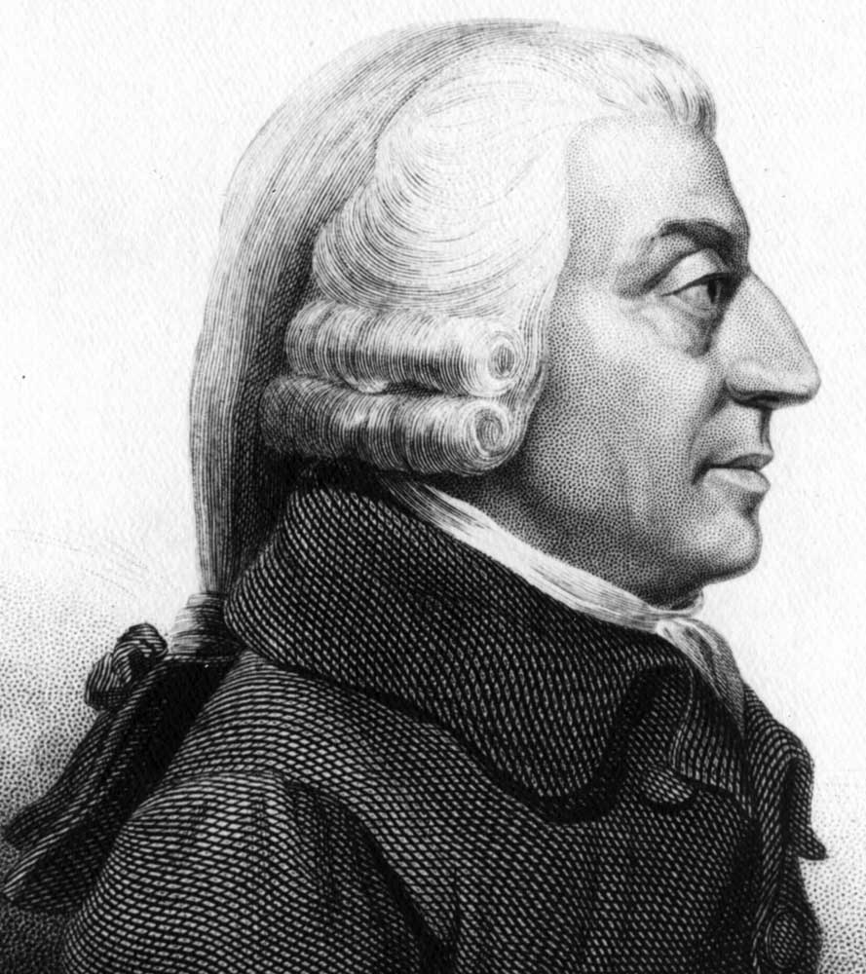

Adam Smith
... calls Mandeville’s views „in almost every respect erroneous” (TMS: 451)
The Wealth of Nations (1776) – “the science of the legislator” – elaborates a regulatory and institutional framework designed to channel selfish behaviour in directions that are also socially beneficial.
Can large parts of social life be subjected to the care of interdependent markets?
Or will there be anarchy and chaos?

Slide 7
2. Man’s natural faculties, the propensity to exchange, and markets
A benign “Providence” has endowed man with the “propensity … to truck, barter, and exchange one thing for another”, which is probably “the necessary consequence of the faculties of reason and speech” (WN I.ii.1-2).
“Man has almost constant occasion for the help of his brethren, and it is in vain for him to expect it from their benevolence only. He will be more likely to prevail if he can interest their self-love in his favour, and shew them that it is for their own advantage to do for him what he requires of them. Whoever offers to another a bargain of any kind, proposes to do this. Give me that which I want, and you shall have this which you want” (WN I.ii.2)

Slide 8
A double coincidence of wants
“It is not from the benevolence of the butcher, the brewer, or the baker, that we expect our dinner, but from their regard to their own interest. We address ourselves, not to their humanity but to their self-love, and never talk to them of our own necessities but of their advantages.” (WN I.ii.2)
“… it is this same trucking disposition which originally gives occasion to the division of labour.” (WN I.ii.3)

Slide 9
Two crucial axioms of The Wealth:
The market is a natural form of organising economic affairs, because it reflects natural faculties of man.
Man’s well-being depends on the proper exertion of his trucking disposition and thus on the functioning of markets, because they lead to an ever deeper division of labour, increase labour productivity and raise income per capita, Smith’s measure of the wealth of a nation.

Slide 10
Free competition:
… involves the absence of barriers to entry in and exit from the various markets
… is the basis of the “system of natural liberty” and “equality, liberty and justice”
… activates both centripetal and centrifugal forces
The former give order and coherence to the economy by disciplining the agents: “good management can never be universally established but in consequence of that free and universal competition, which forces every body to have recourse to it for the sake of self-defence” (WN I.xi.b.5) (Marx was later to speak of the “coercive law of competition”.)
The latter disrupt the economic system and force it to embark on new paths

Slide 11
3. Market prices and natural prices
In a private decentralised economy no ex ante coordination of economic activities; this is reflected in discrepancies between “market (or actual)” and “natural (or ordinary)” prices.
“The market price of every particular commodity is regulated by the proportion between the quantity which is actually brought to market, and the demand of those who are willing to pay the natural prices of the commodity, or the whole value of the rent, labour, and profit, which must be paid in order to bring it thither. Such people may be called the effectual demanders, and their demand the effectual demand; since it may be sufficient to effectuate the bringing of the commodity to market.” (WN I.vii.8)

Slide 12
Natural prices
Natural prices reflect only persistent and systematic forces, market prices in addition temporary and accidental ones.
Natural prices depend on
– the system of production actually adopted by cost-minimising producers and
– real wages paid to workers.
The natural price is the lowest price in the long run, “which sellers can commonly afford to take, and at the same time continue their business” (WN I.vii.11): it covers their costs of production and yields them the ordinary rate of return on capital.

Slide 13
A simple formalisation
p = (1 + r)Ap
A = M + S = M + lw^{T}
p = (1 + r)( M + lw^{T})p
b^{T}p = 1
w = w^{T}p

Slide 14
Gravitation
The natural price is “the central price, to which the prices of all commodities are continually gravitating. Different accidents may sometimes keep them suspended a good deal above it, and sometimes force them down even somewhat below it. But whatever may be the obstacles which hinder them from settling in this center of repose and continuance, they are constantly tending towards it.” (WN I.vii.15)
Market prices are also said to “oscillate” around their natural levels
(Paraphrased in terms of modern economic dynamics: (p, r*) is a stable fixed point that is not necessarily asymptotically stable; if it is not, it is a limit cycle.)

Slide 15
Two premises:
Whenever the quantity of a commodity brought to market is smaller (larger) than effectual demand, the market price will be above (below) the level of the natural price of the commodity. This implies that the commodity-specific rate of profit (and/or the wage rate and/or the rents paid) will be above (below) its natural level.
Profit-seeking producers will decrease (increase) the quantity of the commodity brought to market, if the commodity-specific rate of profit is below (above) the level in other (adjacent) sectors of the economy.

Slide 16
A given fixed point (x*, p*, r*)
r₁ = r₂ = … = r_{m} = r*
d* = s = x*
d*:= the vector of effectual demands
s:= the vector of actual supplies

Slide 17
“Cross-dual models”:
relative prices react upon deviations of actual supplies from effectual demands and
(ii) actual supplies react upon deviations of market prices from natural prices
dp_{j}/dt = f_{j}(d*_{j} – s_{j})
ds_{j}/dt = g_{j}(p_{j} – p*_{j})

Slide 20
Sectoral differences
Sellers’ market
Buyers’ market
Competition is ignited on the “long” side of the market
Price dispersion

Slide 21
5. Improvements
Are ubiquitous: “The establishment of any new manufacture, of any new branch of commerce, or of any new practice in agriculture , is always a speculation, from which the projector promises himself extraordinary profits. These profits sometimes are very great, and sometimes, more frequently, perhaps, they are quite otherwise ... If the project succeeds, they are commonly at first very high. When the trade or practice becomes thoroughly established and well known, the competition reduces them to the level of other trades. (WN I.x.b.43)
They unleash centrifugal forces, which displace the old long-period position of the economy (x*, p*, w*, r*) and define a new one (x**, p**, w**, r**). At the same time they activate the centripetal forces of competition that move the system towards the latter.

Slide 22
Emergence of a R&D sector as a part and parcel of an ever deeper division of labour: “philosophers or men of speculation, whose trade it is, not to do any thing, but to observe every thing, … are often capable of combining together the powers of the most distant and dissimilar objects. In the progress of society, philosophy or speculation becomes, like every other employment, the principal or sole trade and occupation of a particular class of citizens. (WN I.i.9)
The “quantity of science” available to a society decides its members’ productivity and wealth (WN I.i.9).
Smith uses the combinatory metaphor to describe innovations.

Slide 23
Unintended consequences
By pursuing their profit interests, capitalists trigger a process, which eventually, “behind their backs” (Marx), improve the lot of the many, that is, increase also the incomes of the “labouring poor” (WN I.i.1) and are thus beneficial to society as a whole.
This is Smith’s main argument in favour of a market economy. The criticism of self-seeking behaviour from a moral point of view focuses attention on individual motives, but ignores the effects that follow from actions based upon such motives. In a well-governed society self-interested behaviour generates largely socially beneficial results. A narrowly moral point of view prevents one from forming a solid judgement on the subject matter.

Slide 24

6. Asymmetric information, moral hazard and adverse selection
Money and financial markets
Introduction of paper money in France following John Law’s proposal
“Mississippi Bubble” (1719)
Smith compares paper money to “improvements in mechanics”, but is well aware of the dangers involved and speaks of the “Daedalian wings of paper money” (WN II.ii.86)

Slide 25
A „prudent“ and „judicious operation of banking“ is required.
“Mean people” are inclined to become bankers if they are allowed to issue bank notes for very small sums, thus causing “a very great calamity to many poor people who had received their notes in payment.” (WN II.ii.90)
Higher profitability is associated with higher risk.
Bankers “can know very little about [their debtors]”. They give money to “chimerical projectors, the drawers and re-drawers of circulating bills of exchange, who would employ the money in extravagant undertaking” (WN II.ii.77).

Slide 26
Adverse selection
The “sober and frugal debtors”, who “might have less of the grand and the marvellous, [but] more of the solid and the profitable”, would, after careful calculation, be prepared to pay only a lower rate of interest than the “chimerical projectors”. Banks can therefore be expected to go for the chimerical and not for the sober and frugal. This transfers a great part of the capital of a country “from prudent and profitable, to imprudent and unprofitable undertakings” (WN II.ii.77).
Smith advocates a legal upper limit to the interest rate

Slide 27
Regulations of the banking trade
“may, no doubt, be considered as in some respect a violation of natural liberty. But those exertions of the natural liberty of a few individuals, which might endanger the security of the whole society, are, and ought to be, restrained by the laws of all governments; of the most free, as well as of the most despotical. The obligation of building party walls, in order to prevent the communication of fire, is a violation of natural liberty, exactly of the same kind with the regulations of the banking trade which are here proposed.” (WN II.ii.94)

Slide 28
See also ...
Navigation Act
Smith’s view of the monopoly privileges of the Bank of England
... against the background of the dictum “defence is more important than opulence.”

Slide 29
Information and power asymmetries in society
Landlords are indolent and “too often, not only ignorant, but incapable of that application of mind which is necessary in order to foresee and understand the consequences of any publick regulation.” (WN I.xi.p.8)
The worker’s “education and habits are commonly such as to render him unfit to judge even though he was fully informed” (WN I.xi.p.9)
Merchants and master manufacturers are possessed of a “superior knowledge of their own interest” (WN I.xi.p.10)

Slide 30
Robert Lucas jr
“I think of all progress in economic thinking, in the kind of basic core of economic theory, as developing entirely as learning how to do what Hume and Smith and Ricardo wanted to do, only better. (Lucas 2004: 22)
Can one deal with society as a whole in terms of a single “representative agent”? Certainly not.
Lucas’s claim that his analysis is rooted in that of the classical economists is without any foundation.

Slide 31
Deceiving
“The proposal of any new law or regulation of commerce which comes from this order, ought always to be listened to with great precaution, and ought never to be adopted till after having been long and carefully examined, not only with the most scrupulous, but with the most suspicious attention. It comes from an order of men, whose interest is never exactly the same with that of the publick, who have generally an interest to deceive and even to oppress the publick, and who accordingly have, upon many occasions, both deceived and oppressed it.
(WN I.xi.p.1)

Slide 32
7. The “wretched spirit of monopoly”
Monopolies are able “to keep up the market price, for a long time together, a good deal above the natural price” (WN I.vii.20).
“The monopolists, by keeping the market constantly under-stocked, by never fully supplying the effectual demand, sell their commodities much above the natural price, and raise their emoluments … greatly above their natural rate.” (WN I.vii.26)

Slide 33
The wage frontier

Slide 34
A case in point:
Criticism of the East India Company
“It was their interest, not only to degrade in all cases the value of the surplus produce of the colony, but in many cases to discourage and keep down the natural increase of its quantity. Of all the expedients that can well be contrived to stunt the natural growth of a new colony, that of an exclusive company is undoubtedly the most effectual. (WN IV.vii.b22)
The rule of such companies in the colonies was typically violent and cruel. While Smith was a fervent advocate of free trade, he deplored the fact that “The savage injustice of the Europeans rendered an event, which ought to have been beneficial to all, ruinous and destructive to several of those unfortunate countries.” (WN IV.i.32)

Slide 35
8. Concluding remark
According to Smith markets and trade are, in principle, good things – provided there is competition. But competition is always in danger of being narrowed and eliminated, giving way to monopolies, which are highly profitable to monopolists, but spell trouble for many people.
The science of the legislator has the task
to fight superstition and false beliefs in economic matters,
to uncover and debunk opinions that present individual interests as promoting the general good,
and to propose a regulatory framework for markets and institutions that helps to ward off threats to the security of the society as a whole and provide incentives such that self-seeking behaviour has socially beneficial effects.

Slide 36
Fifth Graz Schumpeter Summer School
Economic Stagnation: Problems of Theory and Policy From Malthus to Piketty
July 12-18, 2015
After a long period of sustained growth, the spectre of stagnation in advanced capitalist econo- mies is back again. A major theme at the time of John M. Keynes and Joseph A. Schumpeter, stagnation is once more on the agenda with a vengeance. The Graz Schumpeter Summer School addresses the following questions:
What is the evidence that advanced capitalist economies face the problem of stagnation?
What are the driving forces responsible for stagnation at the beginning of the 21st century?
How is the problem of stagnation related to trends in the distribution of income and wealth,
the exhaustion of natural resources and ecological constraints of economic growth, asyn- chronous demographic trends, the increased power of the financial sector and fiscal imbal- ances etc.?
What are adequate policy responses and institutional innovations?
Can Schumpeterian forces be relied upon to lead out of the depression?
The Summer School discusses these problems at a theoretical, empirical and policy level. It provides a thorough account of the multifarious aspects of stagnation as dealt with by authors from Thomas R. Malthus, via Alvin Hansen to Josef Steindl and beyond, and applies relevant ideas, concepts and tools to contemporary problems.

Slide 37
Contact: University of Graz RESOWI-Centre FE A-8010 Graz, Austria +43 (0)316 380-3595 schumpeter.centre@uni-graz.at
http://schumpeter-centre.uni-graz.at

